Slide 1

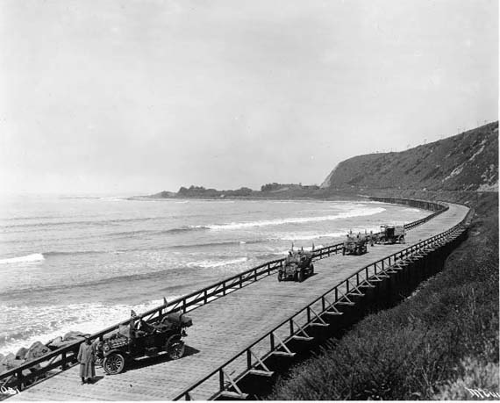
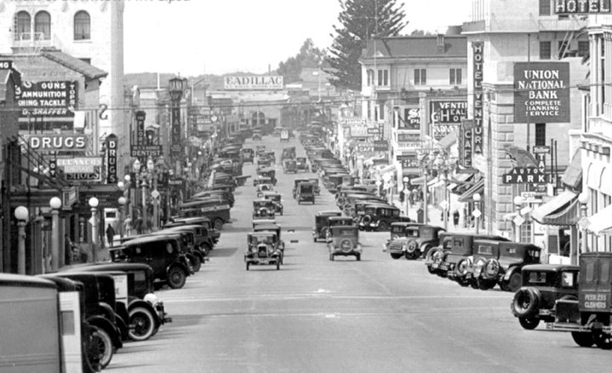
Ventura County Traffic Model (VCTM)
VCTC Update
April 6, 2018

Slide 2
VCTM– A Long History!
First VCTM developed in 1992 with updates and conversions throughout the years with the last update completed in 2009.
Land Use Based (Building Square Footage and LU Acres)
Autos only (No Transit or Goods Movement/HDT Component)
New VCTM developed to Meet Key Application Needs
Environmental Analyses
County General Plan Update
SB 743
Impact Fee/Fair Share Needs
Next Generation of Local Models

Slide 3
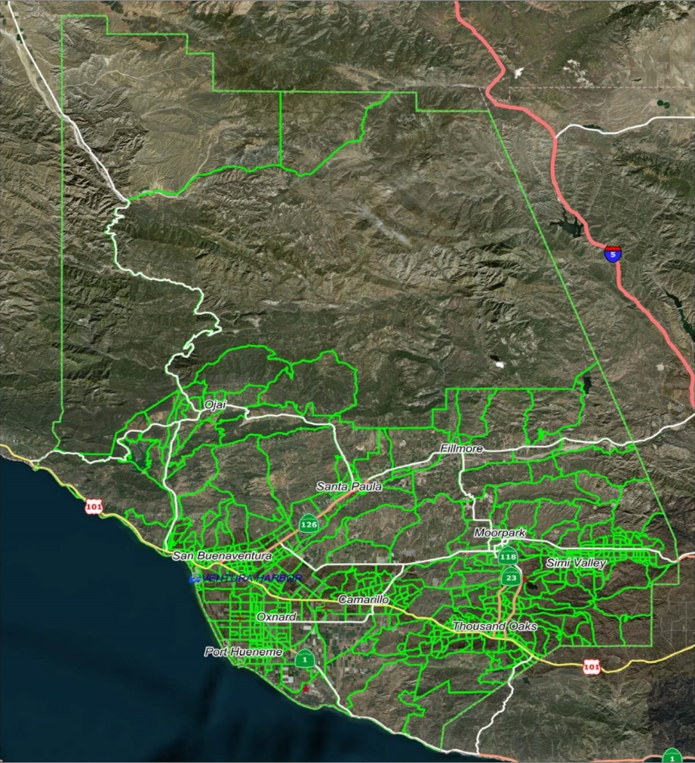
VCTM Consistency
VCTM must be consistent with SCAG 2016 Regional Transportation Plan (RTP)/Sustainable Communities Strategies (SCS) Regional Travel Demand Model
Subarea Model Development Tool
SCAG Zone Structure
11,000+ zones – Used for trip distribution and mode choice
Full Model run time upwards of 7-10 days
VCTM
663 Ventura County zones
Base Year 2012 – Forecast Year 2040
1,021 total zones
Full Model run time 13-15 hours.

Slide 4
Traditional Four-Step Model Process Tries to Replicate Human Travel Behavior
Trip Generation
Do I make a trip?
Trip Distribution
Where do I go?
Mode Choice
What are my means of travel?
Assignment
What route do I choose?

Slide 5
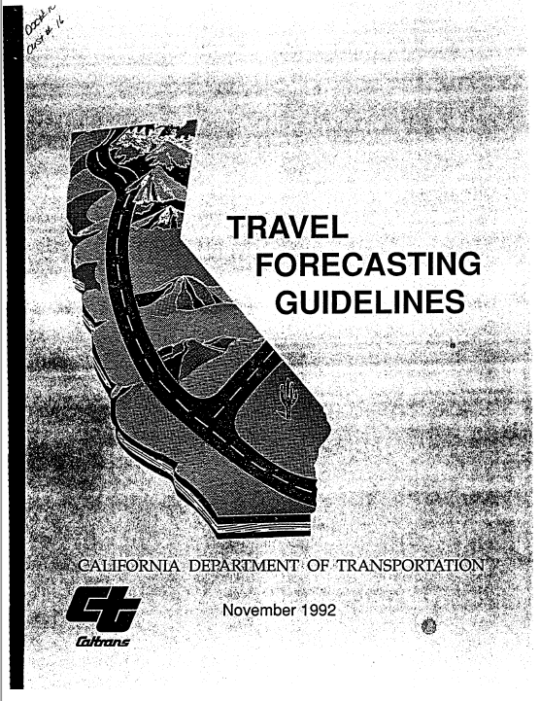
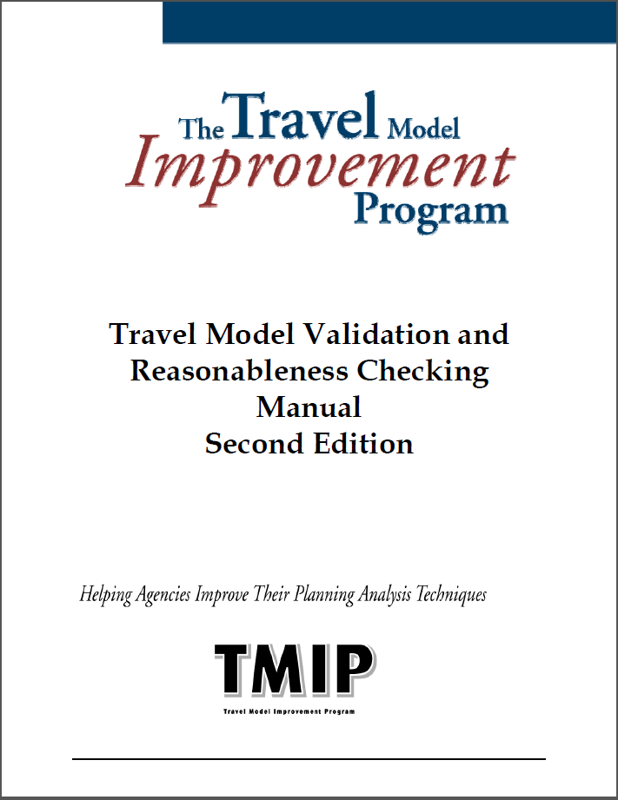
Model Calibration & Validation (Comparing Model Outputs to Real World Counts)
What needs Calibration?
Trip Generation Rates and External Trips
Trip Distribution Parameters
Mode Choice Coefficients
Freeway and Arterial Street Validation Criteria
Count/Volume Comparison (FHWA & Caltrans)
Freeways +/- 7%
Major Arterials +/- 10%
Minor Arterials +/- 15%
Percent Root Mean Squared Error (%RMSE )
Caltrans = 40 and FHWA = 30
Coefficient of Determination (R²) (FHWA & Caltrans)
0.88
Caltrans Standard Deviation
>0.75
Caltrans Criteria from the Caltrans Travel Forecasting Guidelines, November 1992
FHWA Criteria from the TMIP Model Validation and Reasonableness Checking Manual

Slide 6
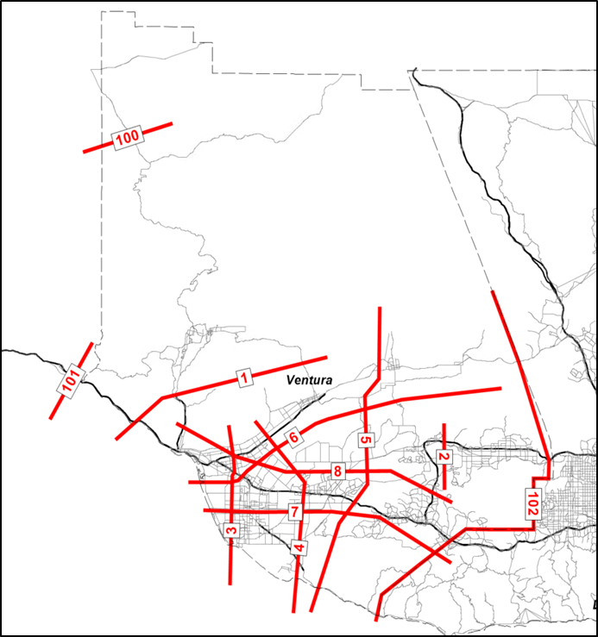
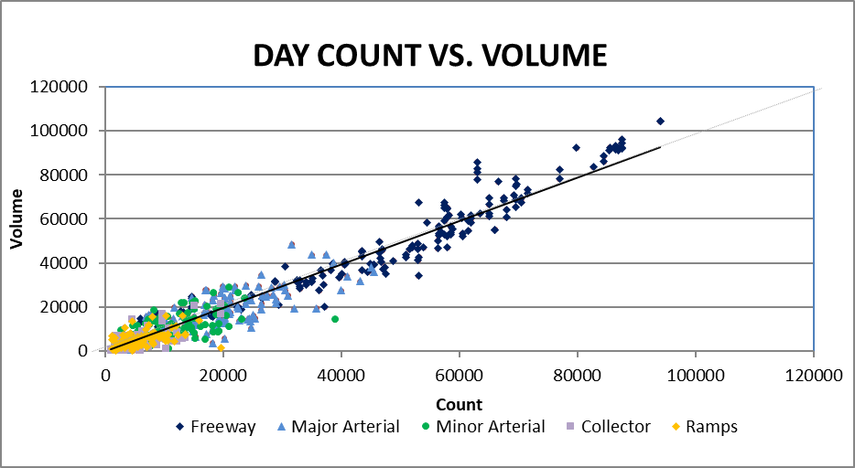
Model Validation Results

Slide 7
Model Outputs
Performance Measures
Assignment Loading (Volumes and Speeds)
Internal/External Origins & Destinations
V/C Ratios on Facilities
Heavy Duty Vehicle Volumes
Transit Ridership by Mode
Active Transportation Modes
Model Application
Functional Class Plots
With number of lanes
With Speeds
Volume to Capacity Plots
Air Quality Speed Bin Outputs
Automated Outputs
Vehicle Miles of travel
Vehicle Hours of travel
Vehicle hours of delay
All outputs developed for the following:
Ventura County, General Plan Districts, TIMF Districts, Cities
By Time of Day (AM peak period, Mid-day, PM peak period, Evening, Night)
Performance Measures

Slide 8
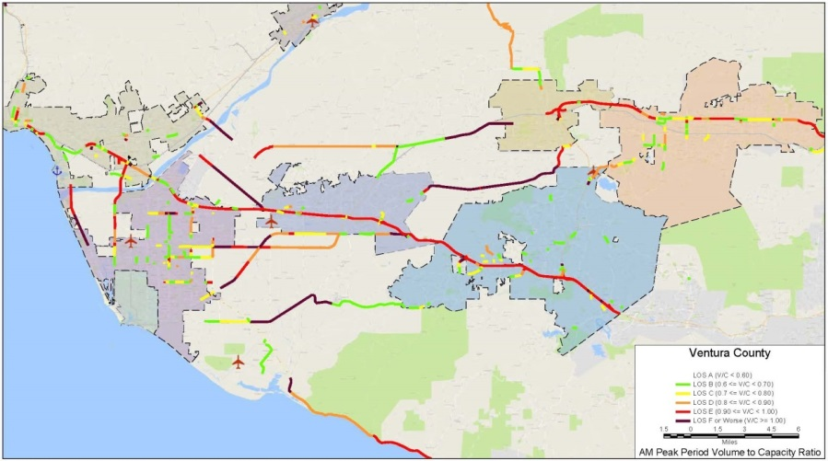
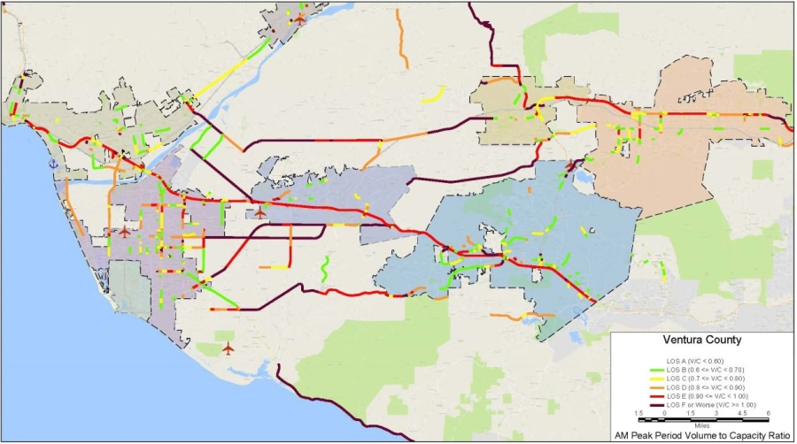
AM Peak Period (6-9 AM)
2012 Validation
VMT = 3,249,750
VHT = 79,550
VHD = 13,200
Average Speed = 40.9 MPH
2040 Baseline
VMT = 3,714,000
VHT = 104,150
VHD = 26,850
Average Speed = 35.7 MPH

Slide 9
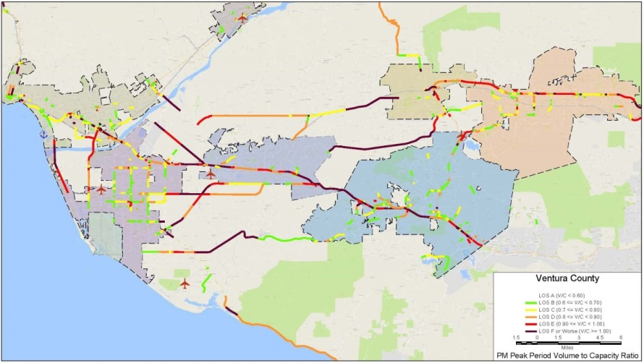

PM Peak Period (3-7 PM)
2012 Validation
VMT = 5,090,500
VHT = 129,300
VHD = 24,100
Average Speed = 39.4 MPH
2040 Baseline
VMT = 5,717,150
VHT = 163,200
VHD = 42,900
Average Speed = 35.0 MPH

Slide 10
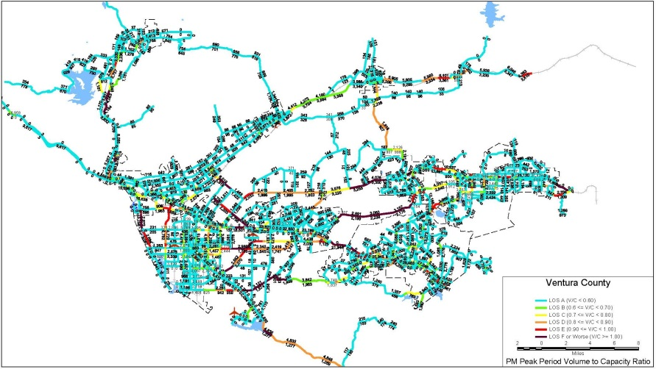
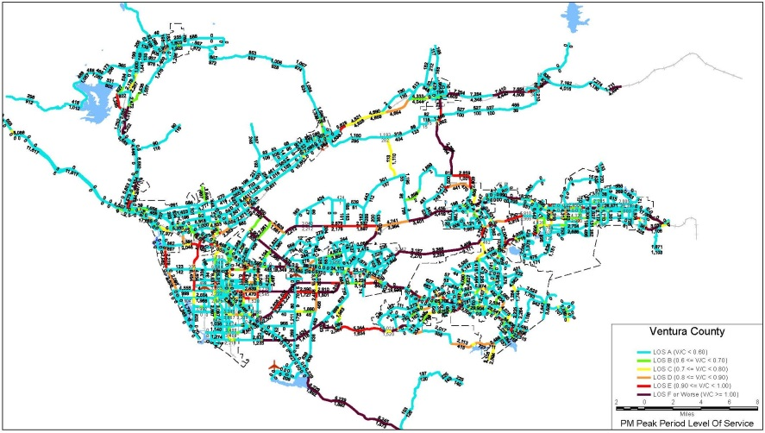
Average Daily Traffic
2012 Validation
VMT = 16,588,600
VHT = 386,800
VHD = 45,700
Average Speed = 42.9 MPH
2040 Baseline
VMT = 18,850,900
VHT = 475,700
VHD = 83,000
Average Speed = 39.6 MPH

Slide 11
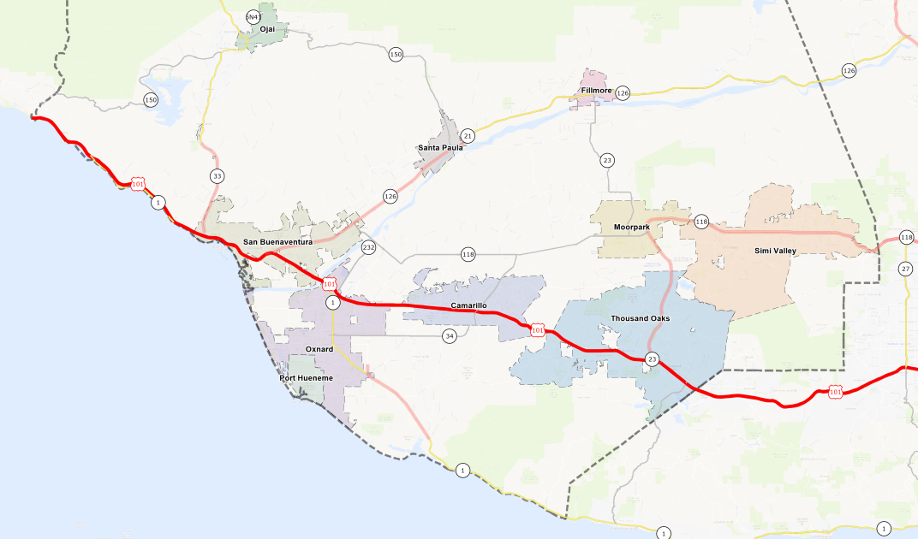
Average Daily Traffic (ADT) and Vehicle Hours of Delay (VHD) U.S. 101
80,497
(2040)
162,642
(2040)
157,805
63,945
(2040)
172,924
(2012)
150,622
(2040)
(2012)
203,849
(2040)
146,252
(2012)
166,597
(2012)
191,821
(2012)

Slide 12
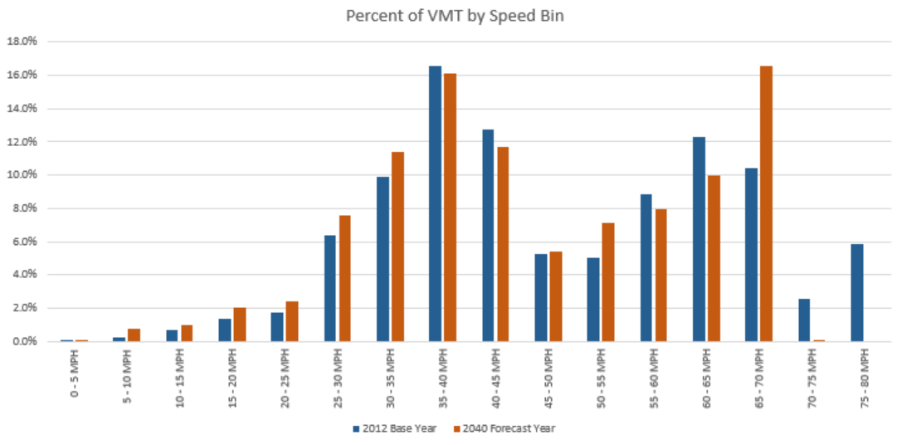
Vehicle Miles Traveled (VMT) by Speed
Increase in low speed VMT
Decrease in high speed VMT
Overall increase in VMT of 14%
2040

Slide 13
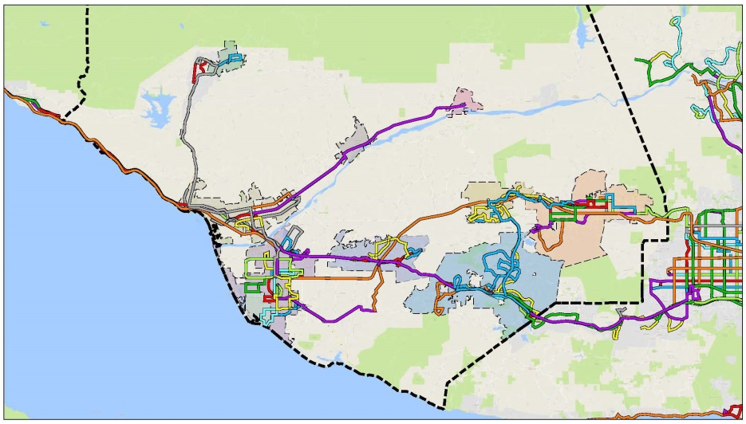
Mode Choice Outputs
Similar Mode Splits between 2012 and 2040
Transit Trips 1 – 1.114%
Non-motorized Trips 4.79 – 5.0%
Increase in total number of trips
3,220,374 (2012) – 3,780,041(2040)

Slide 14



Next Steps
Coordination with General Plan
US-101 HOV Lane
Local Applications and Updates

Slide 15
Ventura County Traffic Model (VCTM)
VCTC Update
April 6, 2018

