Slide 1


Ventura County transportation Commission
Fiscal year 2018/2019 budget
June 1, 2018

Slide 2
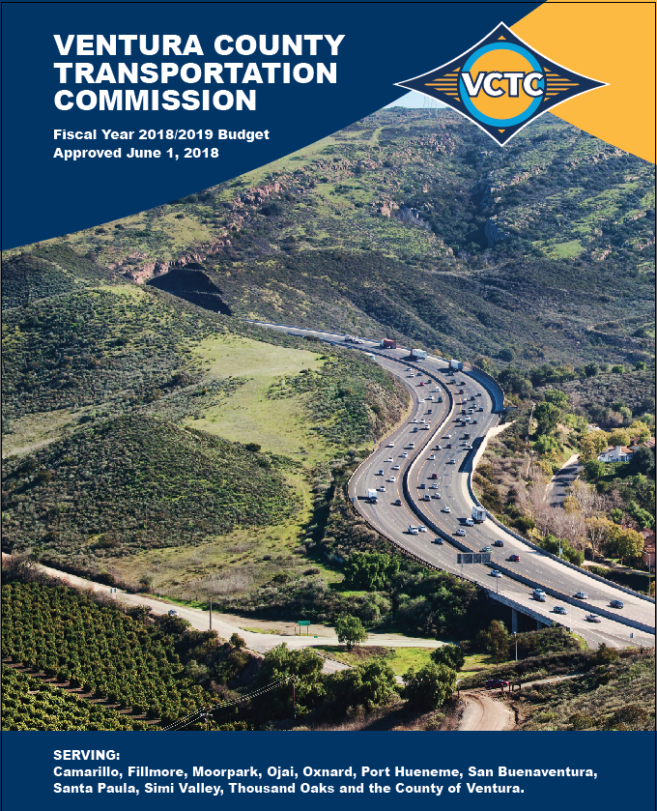
VCTC Budget
Fiscal Year 2018/2019

Slide 3
Fiscal Year 2018/2019 Budget
Final Budget of $74,708,483
$4.4 million increase from the April Draft budget
Revenue Sources

Slide 4
Budgeted Expenditures by Program
Program Budget Categories | Fiscal Year 2016/2017 Actual | Fiscal Year 2017/2018 Budget | Fiscal Year 2018/2019 Budget | % of Change
Transit and Transportation | 16,260,946 | 22,458,350 | 23,353,000 | 4.0%
Highway | 497,394 | 1,605,100 | 5,374,200 | 234.8%
Rail | 6,202,886 | 6,310,984 | 10,181,127 | 61.3%
Commuter Assistance | 478,290 | 691,400 | 539,300 | -22.0%
Planning and Programming | 31,686,170 | 32,558,632 | 34,163,956 | 4.9%
General Government | 1,320,673 | 4,893,001 | 1,096,900 | -77.6%
Total Program Budget | 56,446,359 | 68,517,467 | 74,708,483 | 9.0%

Slide 5
Personnel Costs
Salaries and Benefits = $3,066,900 or 4.1% of budget
21 full-time employees
Conversion of analyst position to manager position
Proposed 2.5% COLA for staff

Slide 6
Transit and Transportation
Significant Changes from Draft Budget
Transit Grant Administration
New FTA pass-through projects +$3.7 million
VCTC Intercity Services
Service adjustments and fare reduction -$0.5 million

Slide 7
Rail
Significant Changes from Draft Budget
Metrolink
Operational and Capital Rehabilitation adjustments +$0.2 million

Slide 8
Planning and Programming
Significant Changes from Draft Budget
Regional Transit
New College Pass Pilot Program +$0.5 million
Transportation Development Act +$0.4 million
Gold Coast Transit District $212,307
Camarillo $ 71,882
Fillmore $ 3,553
Moorpark $ 8,251
Santa Paula $ 6,936
Simi Valley $ 68,539
Thousand Oaks $ 69,317

Slide 9
Where We End Up
Estimated $13.4 million Total Fund Balance (after reserve adjustment)
Available for “general use”
General Fund $ 44,764
Restricted Fund Balances
LTF $ 57,613
STA $ 10,321,900
SAFE $ 3,035,125
$74.7 million budget that is balanced and sustainable*
*Assuming SB 1 remains in place.

Slide 10
QUESTIONS?

Slide 11
Ventura County transportation Commission
Fiscal year 2018/2019 budget
June 1, 2018

