Slide 1

Ventura Local Agency
Formation Commission
Summary of Public Transit Evaluation
Included in Municipal Service Reviews
Prepared by LAFCo in February 2018
for the Cities of Ventura County

Slide 2
What is LAFCo?
Purpose of Local Agency Formation Commission (LAFCo)
Discourage urban sprawl
Preserve open space and agricultural lands
Encourage the efficient provision of government services
Encourage the orderly formation and development of local agencies
Ventura LAFCo Commissioners
2 members of Ventura County Board of Supervisors
  Linda Parks and John Zaragoza (alternate: Steve Bennett)
2 members of city councils
  Janice Parvin and Carmen Ramirez (alternate: Claudia Bill-de la Peña)
2 members of special district boards
  Elaine Freeman and Mary Anne Rooney (alternate: Andy Waters)
1 member of the public
  David J. Ross (alternate: Pat Richards)

Slide 3
Background – Municipal Service Reviews
LAFCo is required to determine a sphere of influence for each city and special district on or before January 1, 2008, and every five years thereafter
Government Code § 56425(g)
Sphere of influence = “the probable physical boundary and service area of a local agency, as determined by the commission”
Government Code § 56076
LAFCo is required to conduct a municipal service review (MSR) prior to, or in conjunction with, sphere of influence updates
Government Code § 56430

Slide 4
Municipal Service Review (MSR)
Government Code § 56430(a)
Growth and population projections for the affected area
Location and characteristics of any disadvantaged unincorporated communities within or contiguous to the sphere of influence
Present and planned capacity of public facilities and adequacy of public services, including infrastructure needs and deficiencies
Financial ability of agencies to provide services
Status of, and opportunities for, shared facilities
Accountability for community service needs, including governmental structure and operational efficiencies
Any other matter related to effective and efficient service delivery, as required by commission policy

Slide 5
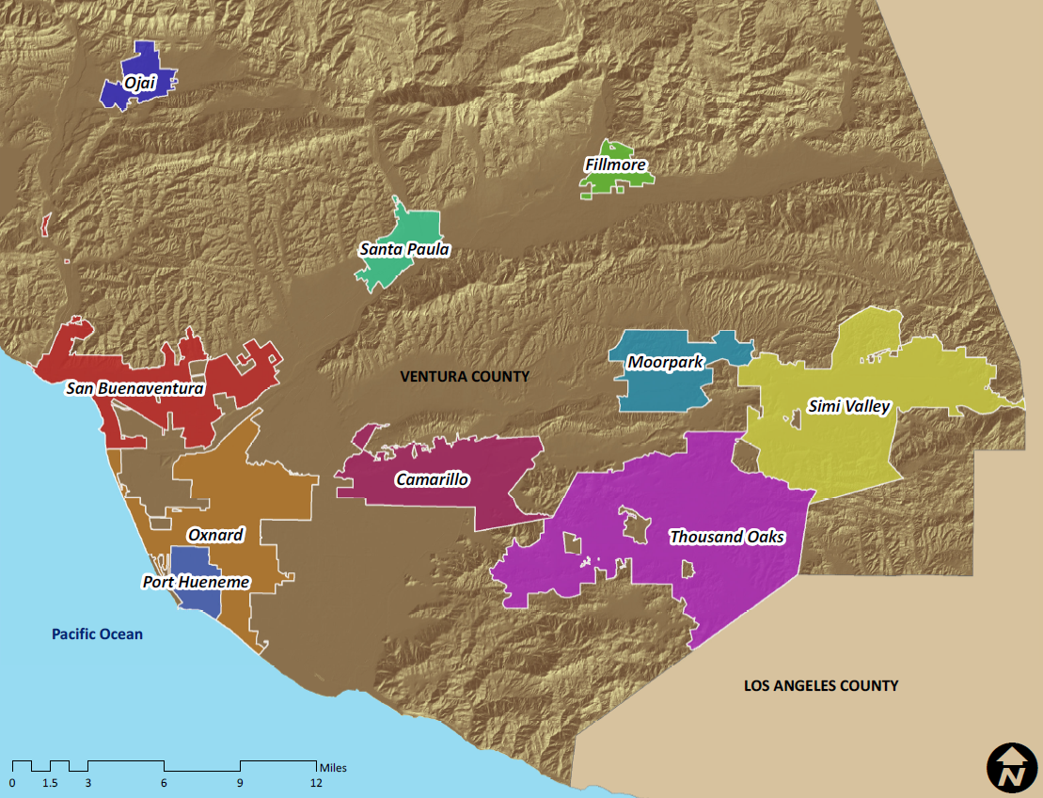
City Services
  Cemetery
  Fire
  Library
  Police
  Recreation and Park
  Solid Waste
  Streets, Highways, and Drainage
  Transit
  Wastewater
  Water

Slide 6
Public Transit – Existing Services
  Cities
    Direct: Cities of Ojai and Simi Valley
    By contract: Cities of Camarillo, Moorpark and Thousand Oaks
  County
    By contract: Kanan Shuttle in Oak Park
  Ventura County Transportation Commission (VCTC) (the regional transportation planning agency of Ventura County)
    By contract: Valley Express (Cooperative agreement with County and Cities of Fillmore and Santa Paula)
    By contract: 8 regional routes throughout Ventura County (including extensions into Los Angeles County and Santa Barbara County)
  Gold Coast Transit District (GCTD)
    Cities of Ojai, Oxnard, Port Hueneme, and Ventura, and unincorporated County area
    Direct: bus service. By contract: paratransit service
  East County Transit Alliance (ECTA)
    Formed by the cities of Camarillo, Moorpark, Simi Valley, Thousand Oaks, and County to better coordinate services among these agencies

Slide 7
Public Transit
Current Inefficiencies/Limitations on Regional Coordination
Ventura County Regional Transit Study (VCTC, April 2012) concluded that public transit in Ventura County was disjointed
  Making connections is difficult and confusing, and “progress toward truly integrated service has been minimal.”
  Challenges in establishing a coordinated system due to “widely spaced, diverse communities and centers where geographic areas do not share common economic, social, and transportation service values.”
Transportation Development Act (TDA) funding
  TDA funding requirements (e.g., farebox revenue)
  TDA funding is restricted to public transit purposes for some jurisdictions, regardless of the extent of need for public transit in those areas
  Limited access to non-TDA funding restricts the ability of transit operators to increase service and still meet farebox recovery requirements
ECTA limitations
  City of Simi Valley operates its transit system using City staff and equipment
  City of Camarillo receives local funding and has a lower qualifying age for senior riders

Slide 8
Public Transit
Progress Toward Regional Coordination
Gold Coast Transit District (GCTD)
  Formed in 2013
  As a district, the GCTD has the ability to make improvements and meet public transit needs systemwide
East County Transit Alliance (ECTA)
  Formed in 2013
  The result of greater awareness for the need to improve coordination amongst transit systems in the East County
Technological advances, transfer agreements, and fare media
  help to simplify and improve trip-planning and the public’s access to public transit information

Slide 9
Public Transit
Opportunities for Further Regional Coordination
  Identify a single agency as the regional transportation authority to oversee and implement the majority of public transit within the County
  Encourage cities not currently members of GCTD to request to join GCTD, or contract with GCTD
  Establish a new transit district to complement the GCTD’s service area

Slide 10
More Information
  Ventura LAFCo website:
  ventura.lafco.ca.gov
  To review MSRs:
  Click Documents & Links
  Then click Municipal Service Reviews
  Any Questions?

